Slide 1
Module 9.2 – Mapping
SLAM

Slide 2
Simultaneous Localization and Mapping
SLAM is used by robots that must construct a map of their environment while localizing themselves
SLAM is used by self-driving cars, agricultural robots, and underwater robots
GPS can be used to aide SLAM, but GPS alone is insufficient for SLAM.
Notes:
Robots may still perform SLAM when they are provided with a map since they can refine and update this map with new information
SLAM is a difficult problem to solve, but it is essential when a robot does not have a perfect map of its environment.
SLAM is made more challenging when the environment is dynamic and there are other moving entities.
Typically SLAM solutions rely on LiDAR or stereo cameras but solutions exist when only radar, sonar, or tactile sensors are available.

Slide 3
Solution Likelihood
SLAM operates by maximizing two likelihoods:
likelihood of the map given the pose and sensor readings of the robot
likelihood of the pose of the robot given the map and the sensor readings
Simultaneously optimizing for both of these will let the robot produce a map while estimating its pose in the map
Notes:
Landmarks are used to assess likelihood. If a robot is near a landmark according to its sensors and it is near that same landmark in the map then the map and its pose are both likely
Choosing the correct landmarks is a critical task that is essential to robustly maximizing the map and pose likelihoods.

Slide 4
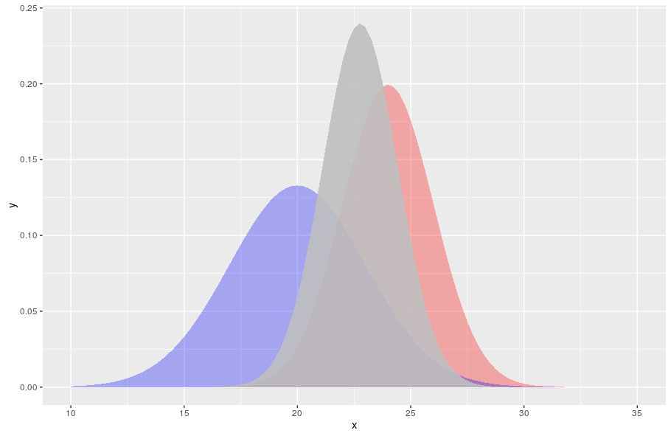
Kalman Filters
Extended Kalman Filters can be used to estimate the pose of the robot and the map
The state vector is the landmarks and the pose of the robot
The map transforms are nonlinear so the basic Kalman Filter is insufficient
Complexity is quadratic with number of landmarks
Notes:
Kalman filters are a straightforward way to implement SLAM because adding the landmarks is a simple extension to the Kalman filter that we used in the dead-reckoning module
The way that landmarks can shift in the map is often non-linear, which is why the Extended Kalman Filter is used.
The main drawback of the Kalman Filter is the complexity. More landmarks can make SLAM more accurate, but Kalman filters can become too slow when the number of landmarks grows.

Slide 5
Particle Filters
Particle Filters can also be used to estimate the map the pose of the robot
Particle Filters have been shown to scale to handle larger numbers of landmarks
FastSLAM is a popular SLAM approach that uses Particle Filters to handle more than 50,000 landmarks.
Particle Filters can achieve a logarithmic complexity with the number of landmarks.
Notes:
Particle filters are the basis for many state-of-the-art SLAM techniques because they have shown the ability to scale better with the number of landmarks.

Slide 6
Identifying Landmarks
Landmarks in the map are required for relocalizing
Landmarks should be distinct from the environment and easy to recognize
Notes:
The image on the slide shows some candidate landmarks that would be readily re-identified.
Corners and edges are good locations for landmarks because they represent a change in the environment.

Slide 7
Closing Loops
In circular environment, small map errors can be compounded to produce incoherent maps.
Real Environment
Map Environment
Notes:
Notice that the loop was not closed, so the robot’s small mistakes yield a map that is completely wrong
Loop closure is a difficult problem because it requires that the robot consider larger parts of the map not just the parts of the map that are nearby.

Slide 8
Monocular SLAM
Recent research has demonstrated successful SLAM with a single monocular camera
LSD-SLAM
ORB-SLAM
Monocular cameras are still not as reliable as depth data from LiDar or stereo cameras, but SLAM is still possible with a single camera

Slide 9
The GPU Teaching Kit is licensed by NVIDIA and California Polytechnic State University under the Creative Commons Attribution-NonCommercial 4.0 International License.

